Slide 1
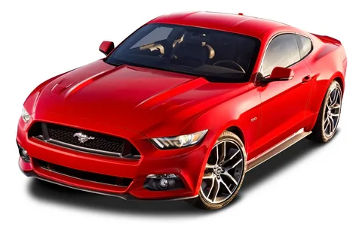
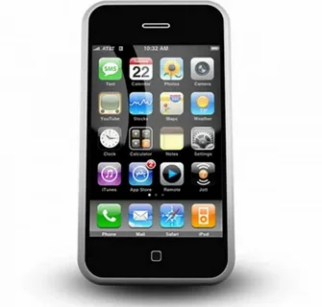
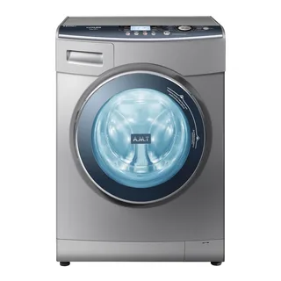
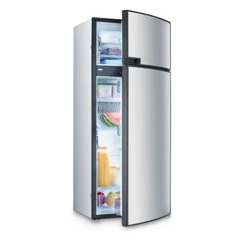
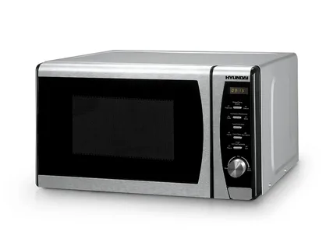

Slide 2
“Where’s logics?”
Развитие ключевых навыков обучающихся с использованием интерактивных аудиоматериалов при подготовке к ЕГЭ по английскому языку

Slide 3
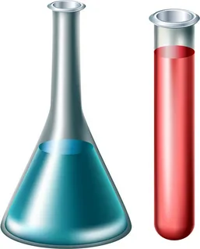
Periodical table of chemical elements

Slide 4
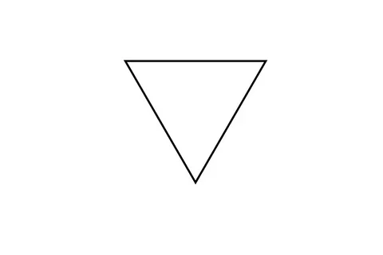
parachute

Slide 5
Computer

Slide 6
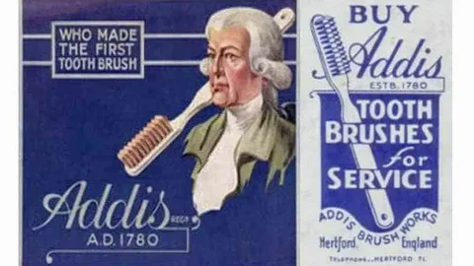
A tooth brush by William addis

Slide 7
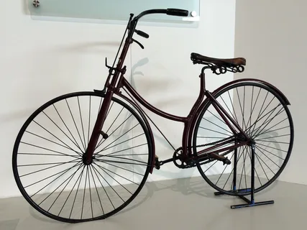
A modern bike by james starley

Slide 8
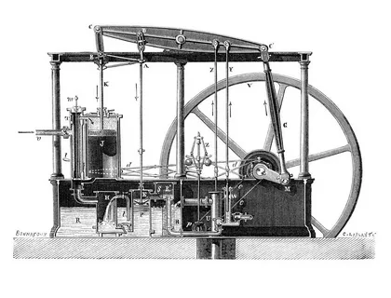
A steam engine by james watt

Slide 9
“The best british inventions”
The topic of the lesson is

Slide 10
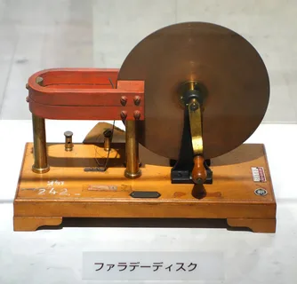
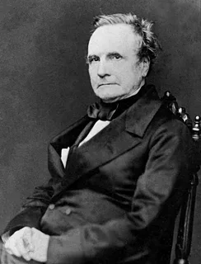
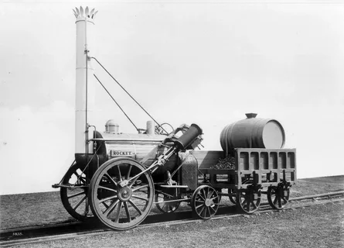
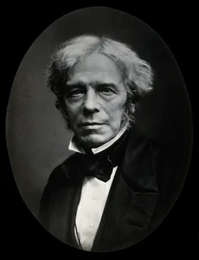
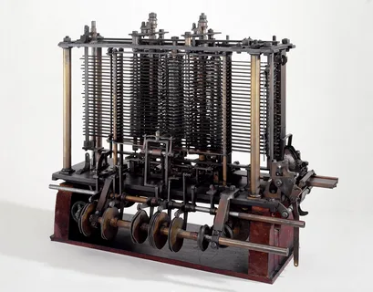
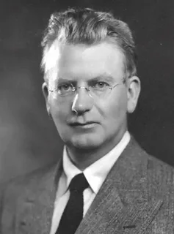
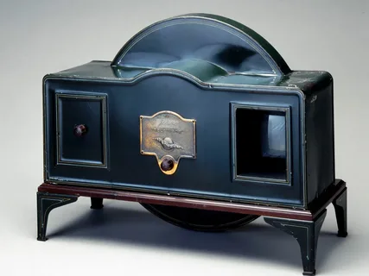
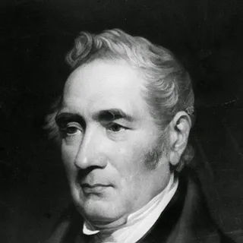
Match the invention with its inventor
An Electric
motor
A Steam
train
A computing
machine
A TV-set
Charles babbage
Michael faraday
John logie baird
George stephenson

Slide 11
use
disuse(d)
misuse(d)
usage
useful
uselessness
useless
user

Slide 12
encourage
discourage
courage
courageous
discouragement
courageously
encouragement

Slide 13
invent
invention
inventiveness
inventor
inventive
inventively
reinvent

Slide 14
develop
development
developing
developed
well-developed
undeveloped
developer
developmental

Slide 15
Text 1
1) ________of the equipment could endanger the lives of staff and students.
2) The church has recently been restored after decades of ___________.
3) Water ________ is increasing every year.
Misuse
disuse
usage

Slide 16
Use the derived words in the following sentences
Text 2
1) He was wrong and __________ enough to admit it.
2) They needed all the _________ they had.
3) You should not let one failure __________ you.
courageous
courage
discourage

Slide 17
Use the derived words in the following sentences
Text 3
1) Technology, innovative and ___________ spirit have characterized our company from the very beginning.
2) No need to __________ the wheel because this one is proven to work.
3) The _________ of the machine spent years refining the design.
inventive
reinvent
inventor

Slide 18
Use the derived words in the following sentences
Text 4
1) This is a region where the transport and infrastructure are _______________ .
2) They made a deal to sell the land to a property ______________ .
3) We will keep you informed of the _______________ .
well-developed
developer
developments

Slide 19
Explain the grammar phenomenon
Text 1.
used to be …
the technological appliances we take for granted today.

Slide 20
Explain the grammar phenomenon
Text 2.
Railways, which played a very important part in the Industrial Revolution
Many of the items we use today were invented …

Slide 21
Explain the grammar phenomenon
Text 3.
… is considered by most to be …
By 1834, he had invented …

Slide 22
Explain the grammar phenomenon
Text 4.
Worked hard to transmit …
The first TV-set could be made …

Slide 23
Langart Audio cards
https://langart.ru/audio-cards/technology/inventions-task-3/

Slide 24
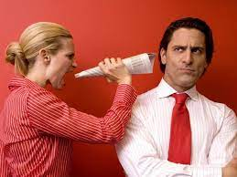
Use the idioms to express your emotions
I am a muddlehead. – У меня каша в голове.
I haven’t a clue. – Я ни в зуб ногой.
I have a bright spirit. – у меня светлая голова.
I used my brains. – Я шевелил мозгами.
I listened with half an ear. Я слушал краем уха.
I fell on deaf ears. – Я хлопал ушами.

