Slide 1
Celebrations
5th form
‘Spotlight-5’
Урок разработан учителем английского языка
МБОУ СОШ с УИОП № 74 города Кирова
Редниковой А.В.

Slide 2
Repeat the sounds
[ei] – take, place, parade, celebrate
[o:] – autumn, August, sauce
[a:] – harvest, part, carving
[ai] – rice, light, pie, July
[ᴧ] – puppet, pumpkin

Slide 3
word formation
celebrate (гл.) – celebration (сущ.)
festival (сущ.) – festive (прил.)
carve (гл.) – carving (сущ.)
compete (гл.) – competition (сущ.)
cook (гл.) – cooker (сущ.) – cookery (прил.)
праздновать
празднование, праздник
water + melon = watermelon
crane + berry = cranberry
fire + work = firework
вода
дыня
арбуз
фестиваль
фестивальный
журавль
ягода
клюква
вырезать
резка, нарезка
огонь
работа
фейерверк
соревноваться
соревнование
готовить
кухонная плита
кулинарный

Slide 4
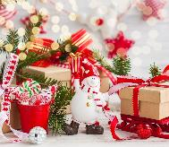
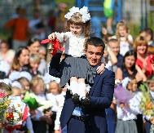
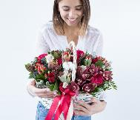
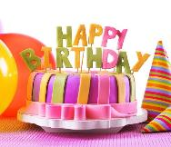
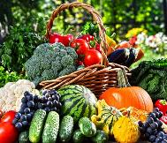
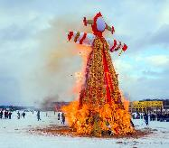
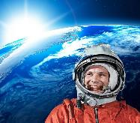
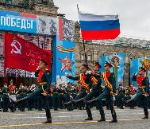
The theme of our lesson is…
Цель урока:
Задачи урока:
научиться рассказывать о праздниках
Узнать, как назвать праздники на английском языке
Вспомнить названия стран, месяцев и времен года
Celebrations
Изучить новые слова и фразы по теме «Праздники»

Slide 5
Translate the words using THE RUSSIAN LANGUAGE
sauce
соус
dessert
десерт
costumes
костюмы
rice
рис
jam
варенье
fruit
фрукты
soup
суп
variety
разнообразие

Slide 6
Translate the words and phrases using the context
We celebrate the New Year on the 31st of December.
праздновать
Victory Day is a popular holiday in Russia.
праздник
Okroshka is a traditional Russian dish.
блюдо
We usually take part in folk games on Maslenitsa.
принимать участие
Street parades take place on Labour Day in May.
проводить, происходить

Slide 7
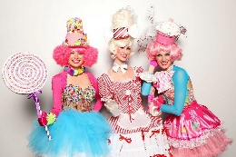
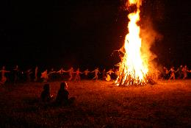
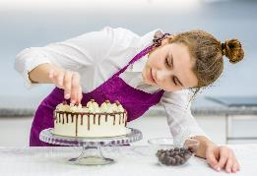
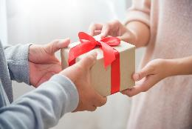
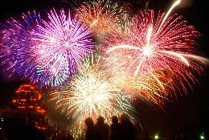
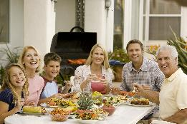
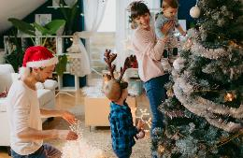
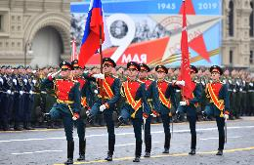
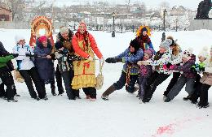
Repeat these phrases
dress up
light bonfire
cook special food
exchange gifts
set off fireworks
have a family dinner
decorate the house
watch the parade
play folk games

Slide 8
Make up the sentences
On Labour Day we usually have street parades .

Slide 9
Find the definition
The word | The definition
1. Puppet | a) a type of food, usually something sweet
2. Treat | b) a plant for making flour
3. Ditties | c) a toy that you can move by putting your hand inside
4. Wheat | d) the time farmers collect their grains, fruit, or vegetables
5. Harvest | e) short, simple songs
Answers: 1c, 2a, 3e, 4b, 5d

Slide 10
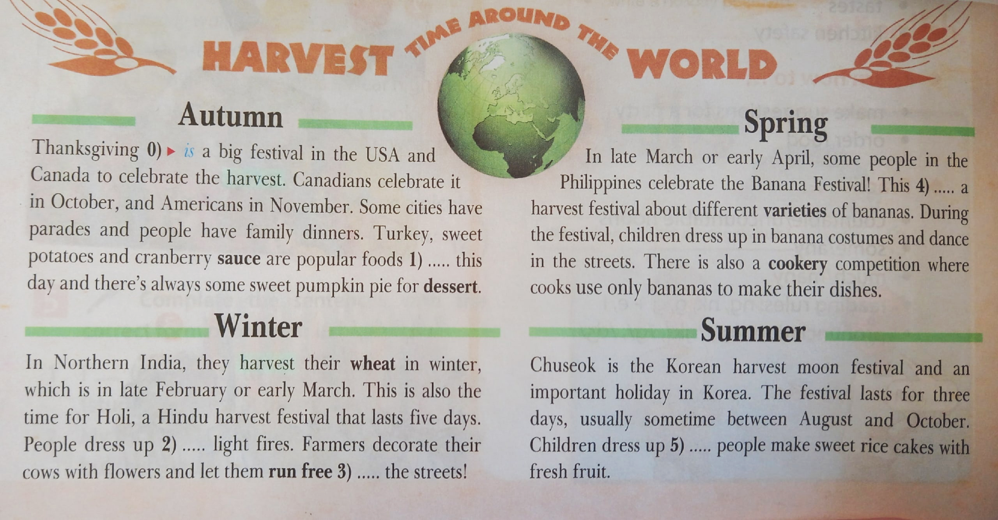
Work with the text
ex 2b, p 96
ex 3a, p 96
ex 3b, p 96
Name of the festival
Country
Time of the year
Special food
Activities
is
on
and
and
in

Slide 11
Fill in the table
Name of the festival | Country | Time of the year | Special food | Activities
Thanksgiving | the USA and Canada | October and November | turkey, sweet potatoes, cranberry sauce, pumpkin pie | have parades, have family dinners
Holi / Hindu harvest festival | Northern India | late February / early March | ----- | dress up, light fires, decorate the cows with flowers and run them free
the Banana Festival | the Philippines | late March / early April | bananas | dress up in banana costumes, dance in the streets, have a cookery competition
Chuseok | Korea | between August and October | rice, fruit | dress up, make sweet rice cakes with fresh fruit

Slide 12
Have a break!
Look left, right, (глазами влево, вправо) Look up, look down, (глазами вверх, вниз) Look around. (глазами по кругу) Look at your nose, (смотрим на нос) Look at that rose, (одну руку вытягиваем и смотрим на нее) Close your eyes, (закрываем глаза) Open, wink and smile. (открываем, моргаем и улыбаемся)

Slide 13
Speaking about the festival
Thanksgiving
I want to tell you about ……………….. .
It takes place in ……………………….. in ………………………… .
People usually …………………and ……………………… during the festival.
………, ……………........, ………………… and ……………. are traditional food for this holiday.
That’s all about this festival.
the USA and Canada
October or November
watch parades
have family dinners
Turkey
sweet potatoes
cranberry sauce
pumpkin pie

Slide 14
Speaking about the festival
I want to tell you about ……………….. .
It takes place in ……………………….. in ………………………… .
People usually …………………and ……………………… during the festival.
………, ……………........, ………………… and ……………. are traditional food for this holiday.
That’s all about this festival.

Slide 15
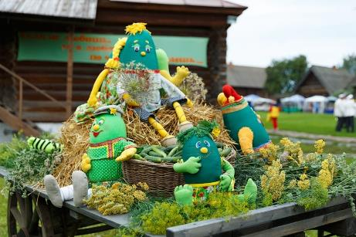
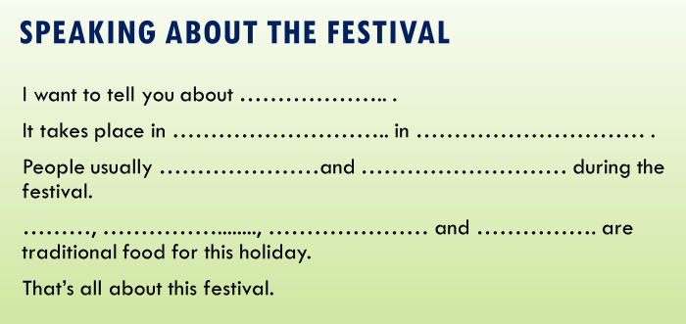
Tell about the festival
Cucumber Day
Cucumber Day takes place in Suzdal in July. An important part of this festival is a street parade. On Cucumber Day people can try original cucumber soup, rolls and jam. Children can take part in puppet shows and workshops on vegetable carving, play folk games and sing cucumber ditties.

Slide 16
Do the task
Put the sentences into the right order
1. Children can take part in puppet shows and workshops on vegetable carving, play folk games and sing cucumber ditties.
2. Cucumber Day takes place in Suzdal in July.
3. An important part of this festival is a street parade.
4. On Cucumber Day people can try original cucumber soup, rolls and jam.
Answers: 2 3 4 1

Slide 17
Do the task
Listen to the text and choose the items:
Astrakhan watermelon festival offers
different competitions
to eat watermelons
watermelon salad
to make watermelon sauce
https://resh.edu.ru/subject/lesson/7510/train/292177/

Slide 18
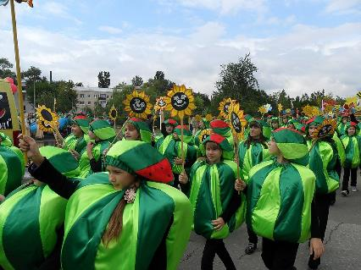
Tell about the festival
Astrakhan Watermelon Festival
The Astrakhan Watermelon Festival is a colourful celebration that takes place in August or September. People dress up and take part in a watermelon costumes competition. Children enjoy watermelon speed-eating. People usually have a big glass of watermelon juice for breakfast, make some watermelon salad with cheese for lunch and for dinner they make a watermelon sauce with fish.

Slide 19
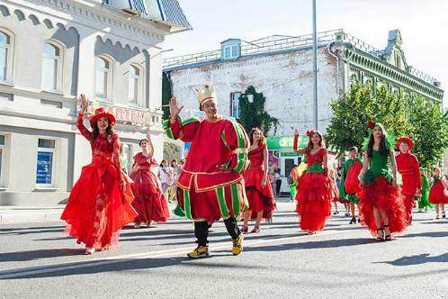
Tell about the festival
Tomato Festival
Tomato festival takes place in Syzran in the middle of August. People dress up in tomato costumes and take part in a street parade. You can visit Tomato town in the local park, walk along Tomato Street and try varieties tomato dishes and on the Tomato Square you can watch a big concert. Don’t forget to buy some fresh vegetables at the local market.

Slide 20
Do the task
Make the sentences T (True) or F (False)
1. Tomato festival takes place in Suzdal.
2. People dress up in tomato costumes.
3. You can visit Tomato town, Tomato Street and the Tomato Square.
4. You can not buy some fresh vegetables at the local market.
False
True
True
False

Slide 21
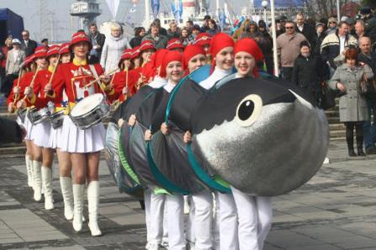
Tell about the festival
Herring Festival
Herring is a popular fish in Kaliningrad region. In April you can visit the Herring festival in Kaliningrad and try a lot of dishes with herrings there. People visit the World Ocean Museum free, buy some fish there and watch the concerts. Also famous cooks compete in cooking herring and it is a great event!

Slide 22
Do the task
Answer the questions:
1. Where does the Herring Festival take place?
2. When does the Herring Festival take place?
3. What can you do there?

Slide 23
reflection
Цель урока:
Задачи урока:
научиться рассказывать о праздниках
Узнать, как назвать праздники на английском языке
WOW!
Вспомнить названия стран, месяцев и времен года
Изучить новые слова и фразы по теме «Праздники»

Slide 24
Список использованных источников информации:
1. Изображения:
https://clck.ru/36JNe9
https://clck.ru/36JNf5
https://clck.ru/36JNfr
https://clck.ru/36JNhJ
https://clck.ru/36JNiS
https://clck.ru/36JNjK
https://clck.ru/36JNkM
https://clck.ru/36JNkx
https://clck.ru/36JNmc
https://clck.ru/36JNnj
https://clck.ru/36JNoG
https://clck.ru/36JNoz
https://clck.ru/36JNrJ
https://clck.ru/36JNs4
https://clck.ru/36JNsY
https://clck.ru/36JNu5
https://clck.ru/36JNuz
https://clck.ru/36JNvZ
https://clck.ru/36JNwm
https://clck.ru/36JNxq
https://clck.ru/36JNzE
https://clck.ru/36JP4U
https://clck.ru/36JP7W
https://clck.ru/36JP8C
https://clck.ru/36JPEr
https://clck.ru/36JNW4
https://clck.ru/36JPGH
https://clck.ru/36JPHV
https://clck.ru/36JPJq
https://clck.ru/36JPLa
https://clck.ru/36JPMF
https://clck.ru/36JPPj
2. Текстовая информация:
https://dictionary.cambridge.org/ru/словарь/английский/treat
https://dictionary.cambridge.org/ru/словарь/английский-для-учащихся/puppet?q=puppets
https://dictionary.cambridge.org/ru/словарь/английский-для-учащихся/ditty
https://dictionary.cambridge.org/ru/ словарь/английский-для-учащихся /crop?q=crops
https://dictionary.cambridge.org/ru/словарь/английский/wheat
https://resh.edu.ru/subject/lesson/7510/main/292172/
https://resh.edu.ru/subject/lesson/7510/train/292177/
https://augustnews.ru/wp-content/uploads/2022/08/festival-syzranskij-pomidor-shestvie-kostyum.jpg
https://www.turizm.ru/ratings/articles/top_12_samyx_vkusnyx_festivalej_rossii/
https://j.etagi.com/stati/prazdnik-k-nam-prikhodit-neobychnye-d/
https://ruwest.ru/upload/iblock/62a/62a8d6cf678bcfe19e39b1160f86b0bc.jpg
http://kenglish.ru/fizkultminutka/zaryadka-dlya-glaz-na-anglijskom-yazyke/

